Slide 1
Multiclass Brain Tumor Classification
Using Convolutional Neural Networks with Transfer Learning
Deep Learning-Based MRI Image Analysis
Peter Mvuma
Big Data Analytics Final Project

Slide 2
Problem Definition & Dataset
Problem: Accurate classification of brain tumor types from MRI images for improved clinical decision-making.
Dataset: 3,064 MRI images from Figshare Brain Tumor Database
Classes: Glioma (1,426), Pituitary (930), Meningioma (708)
Format Challenge: .mat/.h5 files → converted to standardized PNG format
Data Split: 2,144 training, 460 validation, 460 test (stratified)

Slide 4
Data Preprocessing Pipeline
Key Preprocessing Steps
Format Conversion: Extracted 3,064 .mat files to grayscale PNG images
Normalization: Min-max scaling (0-255 → 0-1 range) for consistent intensity
Resizing: Uniform spatial resolution across all images
Augmentation: 20° rotations, 0.15 zoom, width/height shifts, horizontal flips
Result: Done to ensure a Consistent, balanced dataset ready for deep learning

Slide 5
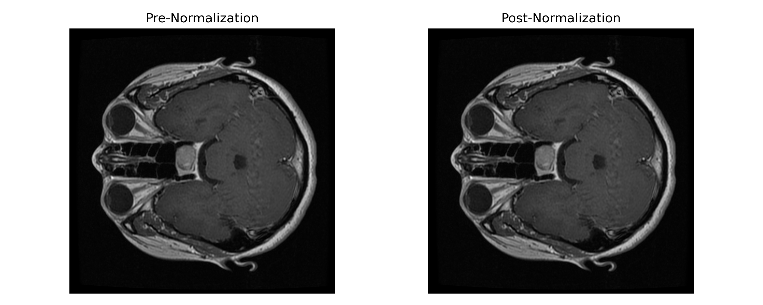

Slide 6
Model Development Strategy
Progressive Phases
Phase 1: Baseline CNN → Simple convolutional architecture
Phase 2: Transfer Learning with ImageNet-Pretrained ResNet-50 and Data Augmentation
Phase 3 (Model 3): ResNet-50 + Callback-Guided Fine-Tuning
Phase 4 (Model 4): ResNet-50 + CBAM Attention + Grad-CAM Interpretability

Slide 7
Baseline CNN Model
Simple Convolutional Architecture
Overall Accuracy
Macro-Avg F1
78%
0.71
Class Performance
Glioma F1: 0.85 | Pituitary F1: 0.90 | Meningioma F1: 0.40
Limitation: Shallow architecture, and was unable to extract meningioma features effectively

Slide 8
Phase 2: Transfer Learning with ImageNet-Pretrained ResNet-50 and Data Augmentation
Two-Stage ResNet-50 Transfer Learning – frozen backbone, then selective layer unfreezing for better tumor-specific features.
Overall Accuracy
Macro-Avg F1
79%
0.75
Class Performance
Glioma F1: 0.80 | Pituitary F1: 0.89 | Meningioma F1: 0.55
Limitation: Transfer learning improved overall accuracy but still left frequent misclassification of meningioma, so the sensitivity for this class remained limited.

Slide 9
Model 3: Callback-Guided ResNet-50
Two-Stage Transfer Learning with Adaptive Optimization
Overall Accuracy
Macro-Avg F1
84%
0.83
Balanced Class Performance
Glioma F1: 0.83 | Pituitary F1: 0.92 | Meningioma F1: 0.73
Best Overall Performance: Macro-AUC 0.933, Micro-AUC 0.923

Slide 10
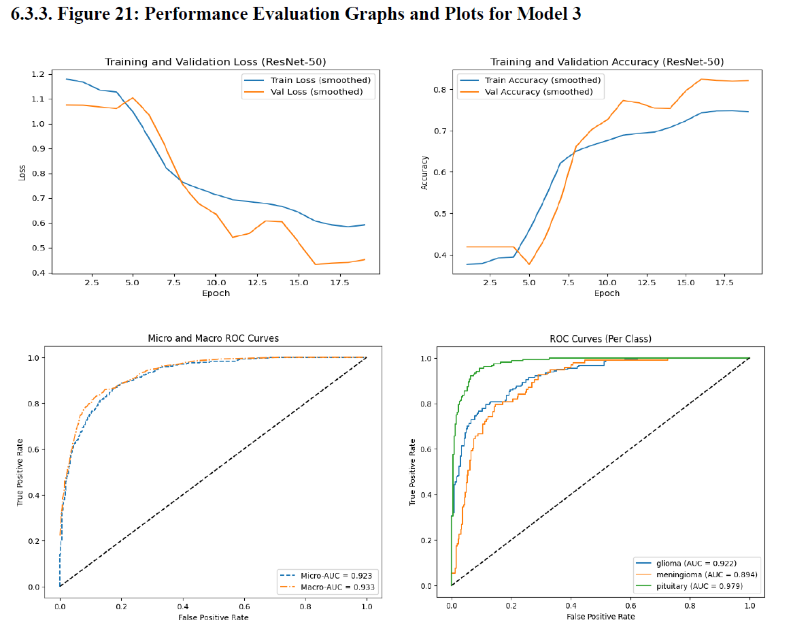
Image extracted from the main report

Slide 11
Model 3: Key optimizations to the Model Architecture
Callback-Driven Training Control
ModelCheckpoint: Automatically saves best-performing weights
ReduceLROnPlateau: Reduces learning rate when validation plateaus (1×10⁻⁵ → 9×10⁻⁷)
EarlyStopping: Halts training at epoch 14, restores best weights from epoch 11
Result: Stable convergence without overfitting
Validation Loss: 1.06 → 0.415 | Validation Accuracy: 0.29 → 0.84

Slide 12
Model 4: ResNet-50 + CBAM + Grad-CAM
Attention Mechanism & Explainability
CBAM: Convolutional Block Attention Module for channel & spatial focus
Grad-CAM: Visual heatmaps highlighting diagnostically relevant regions
Performance: 79% accuracy, macro-F1 0.75 (interpretability trade-off)
Clinical Value: Explainable predictions for clinician trust & audit trails
Note: Trade-off - Model 3 is superior for accuracy, while Model 4 is superior for interpretability. My final choice was Model 3.

Slide 13
Model Metrics Comparison
Model | Accuracy | Macro‑F1 | F1 Glioma | F1 Meningioma | F1 Pituitary
Model 1: Baseline CNN | 0.78 | 0.71 | 0.87 | 0.42 | 0.90
Model 2: ResNet‑50 TL | 0.79 | 0.75 | 0.80 | 0.55 | 0.89
Model 3: Callback ResNet‑50 | 0.84 | 0.83 | 0.84 | 0.73 | 0.92
Model 4: ResNet‑50 + CBAM | 0.79 | 0.75 | 0.84 | 0.49 | 0.88

Slide 14
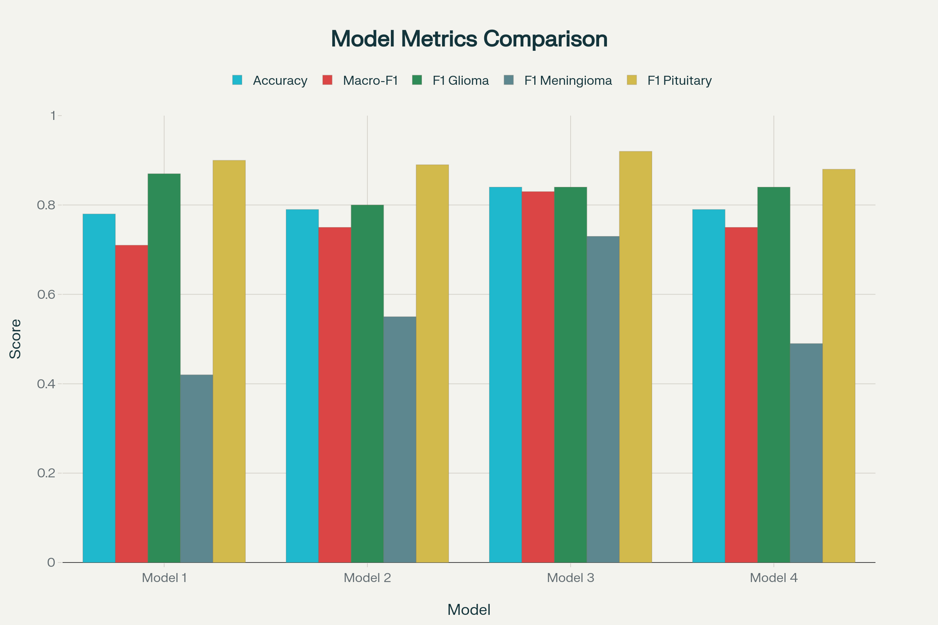

Slide 15
Conclusions and Choice of Model
Model 3 Recommended for Deployment: 84% accuracy, 0.83 macro-F1, best meningioma classification (0.73 F1)
Transfer Learning Impact: ResNet-50 + callbacks improved meningioma F1 from 0.40 → 0.73 (+83% improvement)
Stable Convergence: Callback-guided optimization eliminated overfitting and prediction variance
Clinical Readiness: Model 3 offers reliability & consistency

